Slide 1
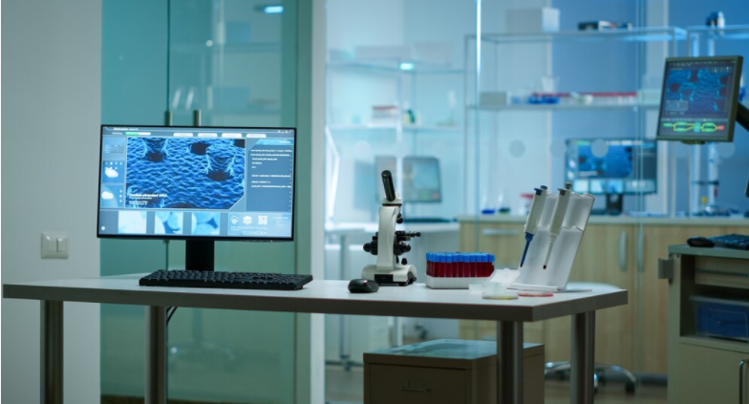
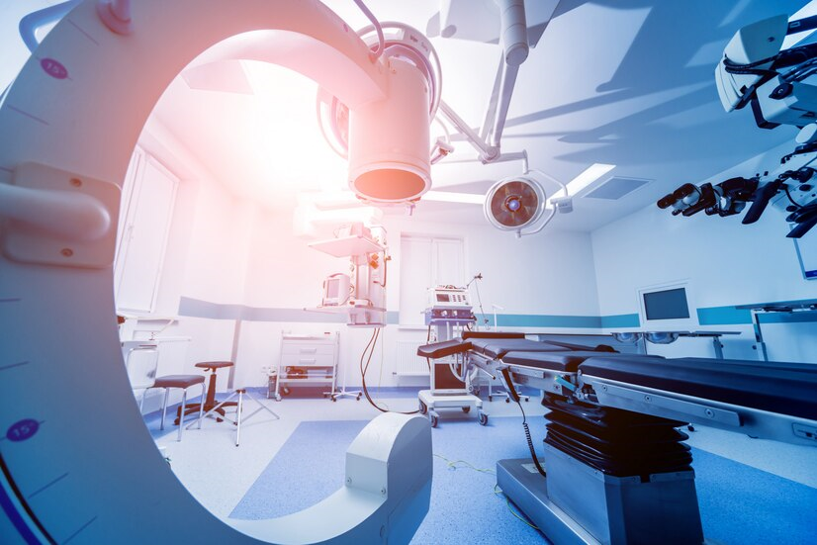
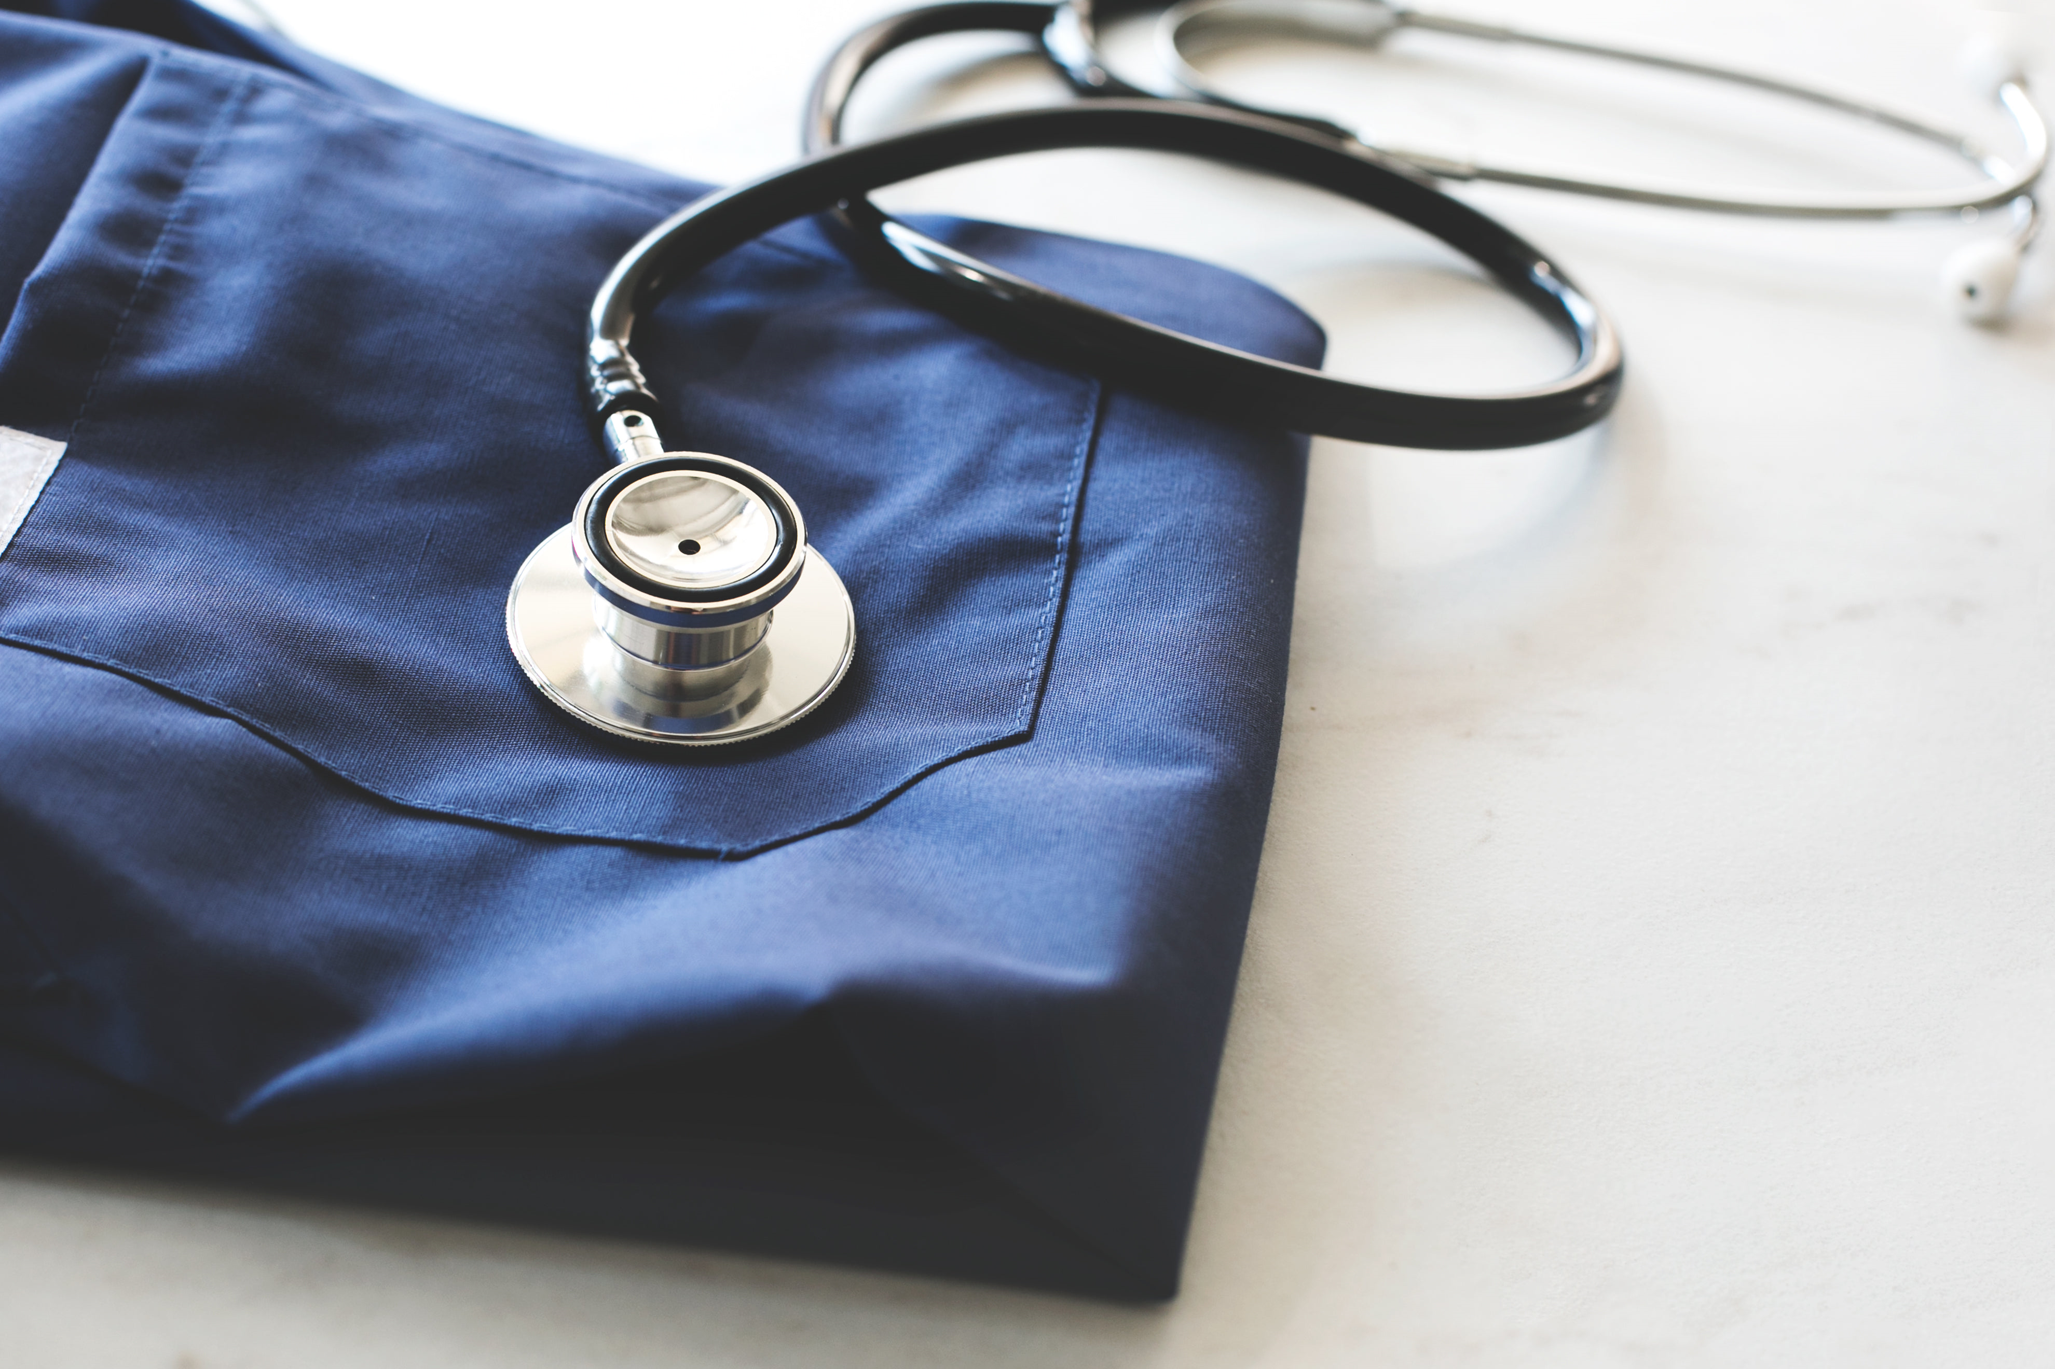
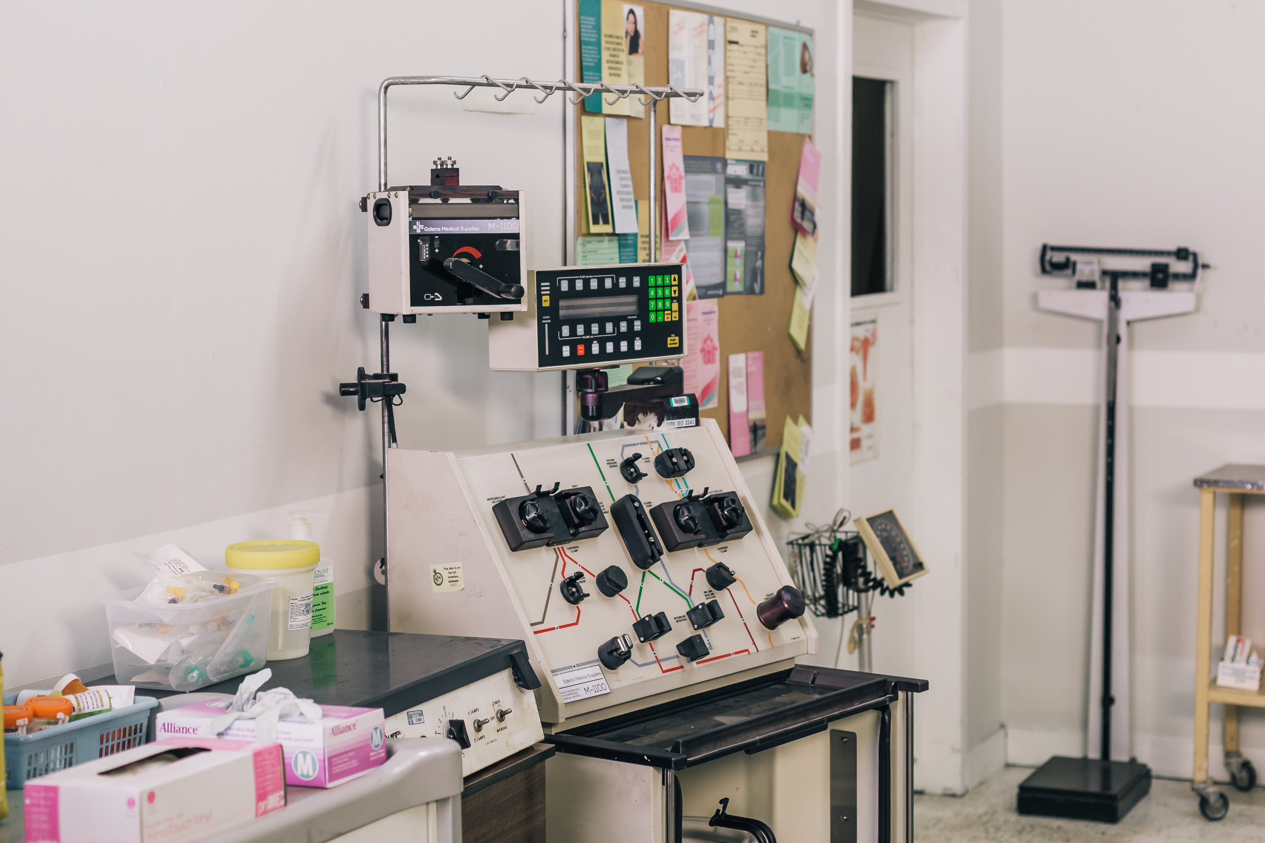
Medical Device Working Group
The European CRO Federation,
one voice towards clinical research
Medical Device Working Group
Chair: Sebnem Yasarogullari

Slide 2
Our Goal
Published Documents-2021
The EUCROF Medical Device Working Group provides a forum for discussion of various aspects of clinical research associated with Medical Devices. It is our objective to share our CRO-based experience with stakeholders involved in the area. On the long term we want to become a recognized partner and aim to be involved in the development of regulative framework. As a group, we contribute extensive experience from our daily work and assist sponsors by guiding them through the implementation of the MDR 2017/745 in EU member states and worldwide. We consider appropriate and good harmonization of regulations to be important for placing and keeping safe and innovative medical devices on the market, as needed for patients and as mandated for qualified Health Care Systems.
Patient access to medical devices frequently starts during clinical investigations. Also, following market approval, ongoing further investigations on safety and long term aspects are required to ensure worldwide safe positioning of devices on the market. The work of our group seeks to target harmonized understanding of current regulatory requirements for clinical investigations with Medical Devices, to contribute to compliant performance of clinical investigations, to support the protection of patients, and to exchange experience with interested groups.
Clinical Evaluation and Clinical Trial: https://www.eucrof.eu/news-eucrof/publications
Medical Device Regulation(MDR) Useful Links: https://www.eucrof.eu/news-eucrof/latest-news)
Members
1 | Şebnem | Yaşaroğulları | Mene Research | Turkey | chair
2 | Antoinette | van Dijk | D.O. Research | Switzerland | co-chair
3 | Karen | Gabriels | Archer Research | Belgium
4 | Natalia | Gordieyvskaya | ULC-Ukrainian Logistic Cluster | Ukraine
5 | Sofoklis | Kyriazakos | Innovation Sprint Sprl | Belgium
6 | Antonio | Pitarque | Sermes CRO | Spain
7 | Mieke | Tempels | Archer Research | Belgium
8 | Rianne | Tooten | Tooten Clinical Trial Services | The Netherlands
Interested in Medical Device WG?
Action Plans
If you are interested in becoming a member of the Medical Device WG,please contact:
EUCROF Secretariat : info@eucrof.eu or
Chair of the Working Group : Sebnem Yasarogullari, sebnem@meneresearch.com or
Co-Chair of the Working Group : Antoinette van Dijk, antoinette.vandijk@doresearch.ch
We are looking forward to hearing from you!
Relationship with Regulatory Authorities
Planning meetings/webinars
Preparation of documents/guidances
IVDR
Combination products
Clinical Investigational Plan vs Clinical Evaluation Plan
Hardware/software
Mapping the available info in one spot
Contact us if you have any suggestions or questions.

